Slide 1

Architecture Validation
AT COMPILE TIME

Slide 2

I am
andrei gordienkov | andrei.gordienkov@volvo.com | @violettape
Notes:
!!!!!!!!!!!!!!!!!!!!!!!!!!!!!!!!!!!!!!!!!!!!!!!!!!!!!!!!!!
!!! Change slide with your information !!!
!!!!!!!!!!!!!!!!!!!!!!!!!!!!!!!!!!!!!!!!!!!!!!!!!!!!!!!!!!

Slide 3

I am
AOP technology advocate
.NET expert
IT Architect @ Volvo
andrei gordienkov | andrei.gordienkov@volvo.com | @violettape
Notes:
!!!!!!!!!!!!!!!!!!!!!!!!!!!!!!!!!!!!!!!!!!!!!!!!!!!!!!!!!!
!!! Change slide with your information !!!
!!!!!!!!!!!!!!!!!!!!!!!!!!!!!!!!!!!!!!!!!!!!!!!!!!!!!!!!!!

Slide 4
And I’d like to talk about…
SAFETY

Slide 5



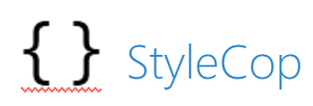
Current state
Notes:
Compiler / Roslyn
IDE
StyleCop
Code Contracts
FxCop

Slide 6
public void Foo(params)
{
Logging params
Validating first param
Then validating second and third param
Logging code
Security checks
Some more logging code
Additional Security checks
A real business code.
That produce some value.
More logging code
And to be sure that everything is recorded log one more time
}

Slide 7
[Security(Role)]
public void Foo([Validation] params)
{
A real business code.
That produce some value.
}

Slide 8
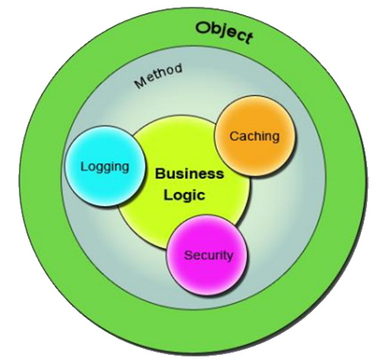
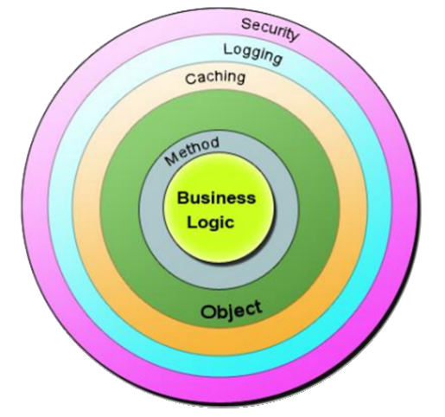

Slide 9
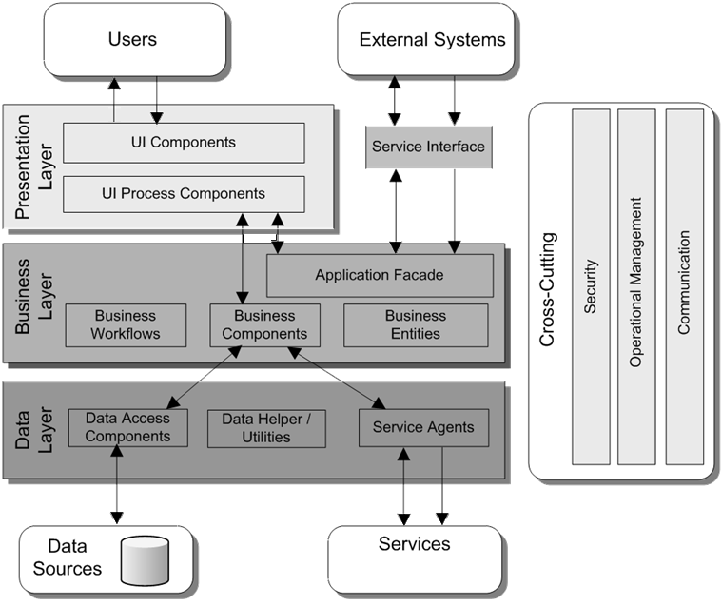

Slide 10

Aspect Oriented Programming
In computing, aspect-oriented programming (AOP) is
a programming paradigm that aims to increase modularity by allowing the separation of cross-cutting concerns.

Slide 11




Frameworks
Fody
PostSharp
Mono.Cecil
xxx.Interceptor
Notes:
https://www.youtube.com/watch?v=vp6a8AX44xM

Slide 12

How does AOP work?

Slide 13
“Magic” can be of two types
IL Weaving
True magic – almost no limitations
Interception
Imposters – works as Decorator pattern

Slide 14

PostSharp
https://www.postsharp.net/
+ Production ready
+ IDE integration (i.e. no black magic)
+ Set of predefined aspects
- Price for Ultimate version
but there are discounts, ask for it

Slide 15
Boring technical details
Support Visual Studio from 2012 SP2 to 2017
C# 1.0 – 7.0
.NET Core 1.1, .NET Standard 1.3
Async support in aspects
http://doc.postsharp.net/requirements

Slide 16
Build-in Features
Restricting Interface Implementation
[InternalImplement]
Controlling Component Visibility
[Internal]
[Protected]
Force Naming Conventions
[NamingConvention]
Developing Custom Architectural Constraints

Slide 17
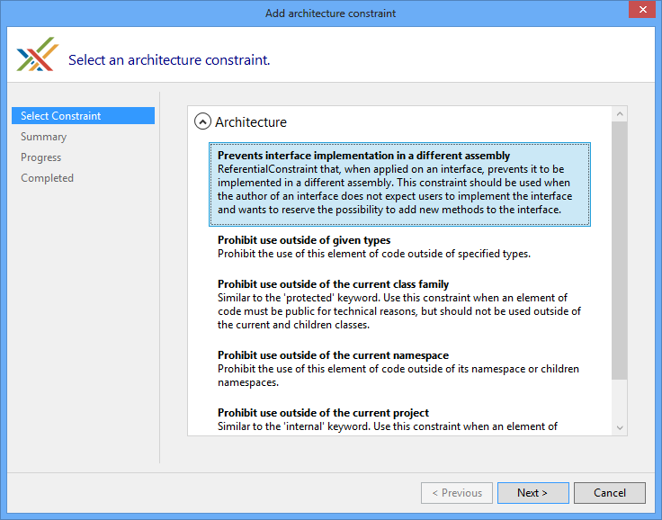
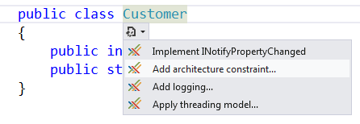
How to apply?

Slide 18

Demo for build-in constraints
[Internal]
Protecting public constructor for IoC/DI
[InternalImplement]
Protecting implementation of interface
[NamingConvention]
Speaks for itself

Slide 19
Debugging
Set breakpoint
Run VS command line
Type:
msbuild MyProject.csproj /T:Rebuild /P:PostSharpAttachDebugger=True

Slide 20
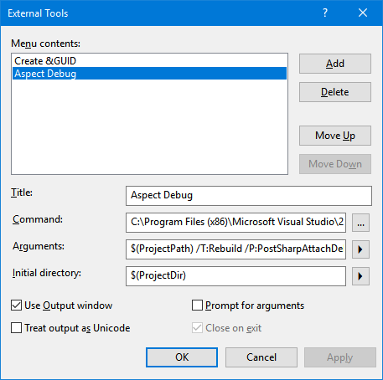
Debugging – true lazy way
Tools > External Tools… (+ toolbar +hotkey)
You can write tests also http://doc.postsharp.net/testing-build-time-logic
Settings for Visual Studio 2017
C:\Program Files (x86)\Microsoft Visual Studio\2017\BuildTools\MSBuild\15.0\Bin\MSBuild.exe
$(ProjectPath) /T:Rebuild /P:PostSharpAttachDebugger=True
$(ProjectDir)

Slide 21
Available constraints
Assembly/Type/Property/… level aspects
Analyze and validate code in assembly/type/property
ScalarConstraints
Analyze usage within single assembly
ReferentialConstraints
Analyze usage within whole solution

Slide 22
How to write constraint?

Slide 23

Identify an annoying problem
that can be possibly checked automatically
Step 0

Slide 24
Select one of constraints type
public class TypeLevelConstraint : TypeLevelAspect {
public override bool CompileTimeValidate(Type type) {
return base.CompileTimeValidate(type);
}
}
Step 1

Slide 25
Select one of constraints type
public class MyConstraint : ReferentialConstraint {
public override void ValidateCode(object target, Assembly assembly) {
base.ValidateCode(target, assembly);
}
public override bool ValidateConstraint(object target) {
return base.ValidateConstraint(target);
}
}
Still step 1

Slide 26

Use your imagination and some magic
of PostSharp and Reflection
Step 2

Slide 27

Enjoy & Share knowledge
and code samples
Step 3

Slide 28

Demo
Prohibited usage of the „static” modifier
IoC/DI usage violation
Instantiation violation
Override violation

Slide 29
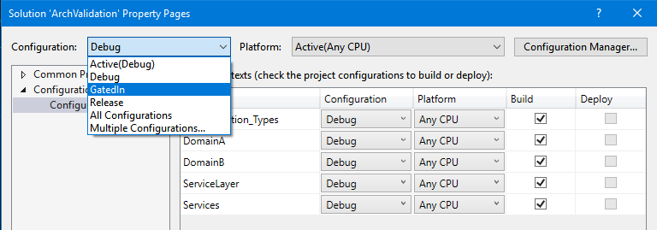
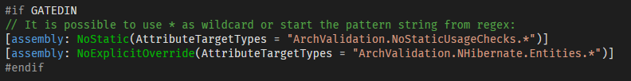
Compilation time
To control time spend in compilation use:
Build configuration
Conditional compilation symbols

Slide 30
Drawbacks & Limitations
Limitations:
Can’t analyze code „as source code”. Instead use Roslin.
Drawbacks:
Compilation time depends on intensity of instrumentation

Slide 31
Key takeaways
Simple, but powerful constraint checks already included.
Quite complex custom compilation-time validation is possible.
Easy to switch on\off locally and on build agents.
Validation aspects are debugable and testable
It’s like TDD, but about design and architecture – to protect the developer in complicated code base.
YOUR CODE CAN BE MORE SAFE WITH
CUSTOM COMPILE TIME VALIDATION

Slide 32
Links
Thank you!
E-mail: anderi.gordienkov@volvo.com
Twitter: @violettape
https://www.postsharp.net/faq - technical stuff
https://www.manning.com/books/aop-in-net
https://github.com/postsharp/PostSharp.Samples
http://doc.postsharp.net/testing-build-time-logic
https://github.com/VioletTape/ArchValidation

